Slide 1
Mutual Funds: Ready for the next leap
20 September, 2016

Slide 2
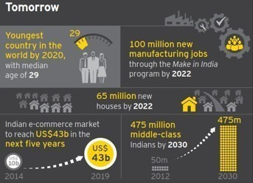
India: a promising outlook One of the world’s top three growing economies by 2020
A Buoyant Tomorrow
EY’s 2015 India attractiveness survey
How do you see India in 2020?
Among the top three growing economies in the world
37%
Among the world’s leading three destinations for manufacturing
35%
A regional and global hub for operations
21%
Notes:
According to EY’s 2015 India Attractiveness Survey, 32% of the respondents ranked India as the most attractive investment destination globally, while 60% placed the country among the top three investment destinations. The country’s vast domestic market and low-cost, skilled labor market continue to be its most attractive features.

Slide 3
Mutual Fund industry: key growth drivers
Strong macroeconomic fundamentals
Favorable demographics and rising income levels
Growth drivers
Current low penetration in terms of investor wallet share
Government initiatives are driving investments from global investors
Notes:
According to World Bank data, after taking 60 years to become a US$1 trillion economy, India added the next trillion in only seven years and crossed the US$2 trillion landmark in 2014. The expected per capita gross national income growth over the next decade could propel India in to the “upper middle income country” category
India’s falling dependency ratio provides strong support for long-term growth. By 2021, 64% of India’s total population will be in the working age group. Millennials are the largest and fastest-growing adult segment across the globe and represent the greatest opportunity for the asset management industry “The rise of the millennials”, Livemint, 1 Dec 2015
Low penetration, other investment opportunities, b 15 cities
FDI, (142 to 50 in ranking), Ranking for indian states,

Slide 4
Mutual funds in India has grown at a brisk rate
Record AUM growth since 1990s – Mutual fund industry has grown its AUM base at the rate of 20% CAGR since FY03
Competitive landscape dominated by large players - The market share of the top 10 players amounted to 79.5% in March 2016, while the top 5 players held a 55.6% market share
Increased retail participation - The industry has been successful in improving the share of retail and high net worth individuals (HNIs) in total AUM from 43% in March 2009 to 51% in March 2016.

Slide 5
Robust AUM growth of past decade expected in future too
1
Products
Globally mutual fund industry is well-established; however, penetration remains low in Asian markets, including India. High potential for growth driven by increased retail participation in equity funds. ETFs, REITs and AIFs are upcoming products.
2
Digital
Emerging technologies – FinTech, blockchain, analytics, mobile, cloud and social media - are transforming the future of asset management. Rise of direct-to-customer (D2C) platforms and robo-advisors are changing rules of distribution.
3
Regulations
Post the global financial crisis, a more stringent and complex regulatory environment with multitude of regulations. Best practices in key global markets – US, Europe Union and Asia-Pacific – may be replicated in India. Newly introduced Goods and Service Tax (GST) to impact the Indian MF sector.
Notes:
Products: Intnl The global asset management industry is witnessing a shift in flows from traditional mutual funds to alternative products; passive investing and liquid alternative mutual funds are becoming popular in the western world Stellar growth of ETF products continues in western markets. Pension there is a shift towards defined contribution (DC) plans and increasing demand for investment solutions
India: Debt funds dominate the AUM mix; however, equity funds have driven AUM growth recently SEBI needs to focus on rationalizing similar product offerings
There is a need for deepening pension coverage in India
Digital: IntnlTechnology is helping asset managers revamp their business models — standardize, centralize and outsource
India: Processes are becoming paperless, efficient, easy and real-time
Digital is helping fund houses enhance distribution reach; industry-wide digital platforms, such as platforms by stock exchanges and MF Utility, are facilitating easier distribution SEBI is also planning to allow e-commerce firms to sell MFs
Regulations

Slide 6
Product trends
Global Markets
Indian Markets
Asset class mix
Equity funds continued to dominate in 2015
Money market management funds had the highest inflows across asset classes in 2015
In India debt schemes continue to dominate AUM
Equity funds have witnessed significant inflows in FY15 and FY16
Specialty products & investment solutions
Specialty funds
International funds
Emergence of commodity MFs
Rise of liquid alternative MFs
Hybrid, equity, debt, retirement, FMPs, tax-free bonds & specialty funds
REITs
Alternative funds
Exchange Traded Funds
Stellar growth of ETFs continues
Continued to achieve market share gains with record growth over five-fold over the past decade
ETFs are yet to gain popularity with Indian investors
Pension Funds
Asset diversification has gained momentum among pension funds
Only 9%—10% of the population is covered by some type of pension benefits

Slide 7
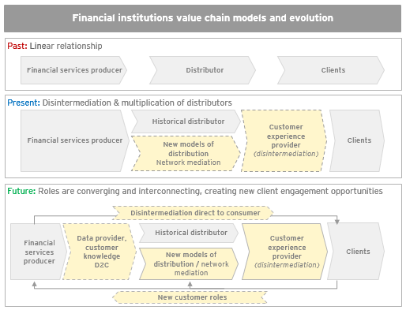
Digital: rise of direct to customer (D2C) model
Technological is creating new playing fields throughout the distribution value chain
Asset managers globally are focusing on consumer branding, consistent client experience, strong social media presence, reduction in product proliferation and risk management and controls
Digital technology is used as a key driver for standardisation, centralisation and outsourcing
Tools like mobile, social media, big data and analytics, FinTech, cloud computing, robo advisors and block chain to increase touch points with customer and distributors

Slide 8
Digital: transforming asset management in India
Technology is a crucial element across MF operations
1
Creating efficiencies
Paperless experience and transaction process (E-KYC and online platforms for buying and selling MFs)
2
Enhancing distributors reach
Industry-wide digital platforms supporting MF distribution in India (stock exchange platforms, MF utility and possible e-commerce platforms for future)
3
Robo advisors
Automation redefining many fields and offering less expensive modes to reach a wider audience

Slide 9
Regulations
Regulator has introduced / enhanced several guidelines around transparency, risk management, investor protection, disclosures, accountability, valuation policy, advertisement code, etc.:
Additional disclosure requirements in offer documents
Mandatory color code system with a 'riskometer' containing five levels of risks introduced
Increased focus on rationalising the distribution commission
In addition to the existing ceiling, regulator may bring down the ratio further in a phased manner
Rationalisation of product suite by putting restrictions around the types of funds and limiting the number of funds under management
Stricter investment limits for debt oriented funds
Ease of redemption norms

Slide 10
Thank you

